Slide 1
Dependency parsing

Slide 2
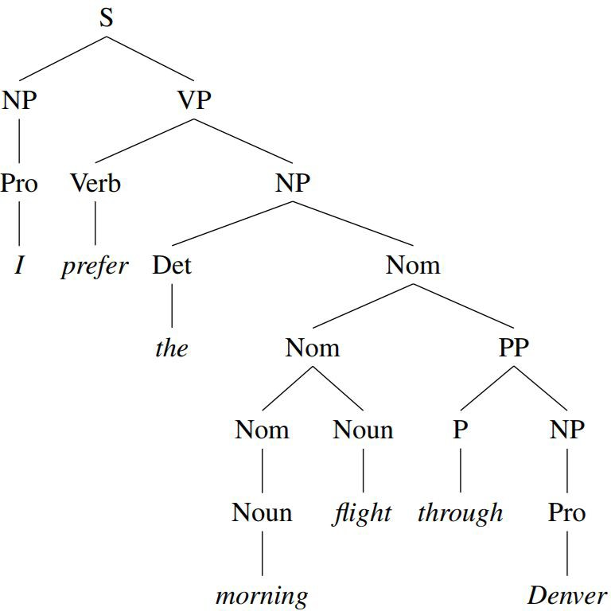
Constituent (phrase-structure) representation

Slide 3
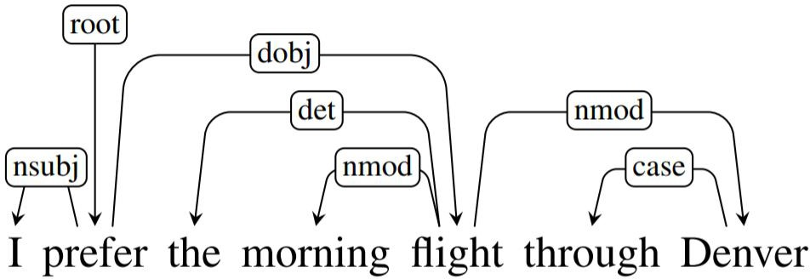
Dependency representation

Slide 4
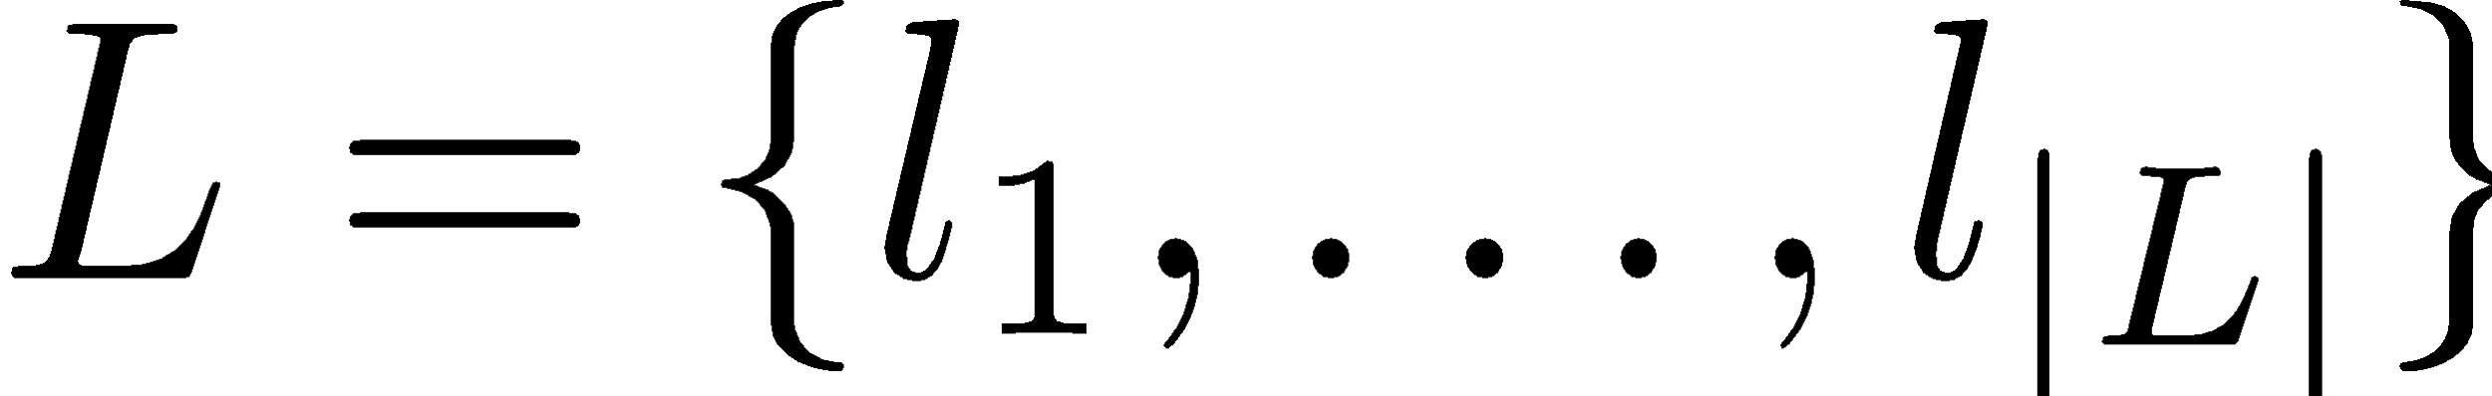



Dependency representation
A dependency structure can be defined as a directed graph G, consisting of
a set V of nodes – vertices, words, punctuation, morphemes
a set A of arcs – directed edges,
a linear precedence order < on V (word order).
Labeled graphs
nodes in V are labeled with word forms (and annotation).
arcs in A are labeled with dependency types
is the set of permissible arc labels;
Every arc in A is a triple (i,j,k) representing a dependency from
To with
label .

Slide 5
Dependency vs Constituency
Dependency structures explicitly represent
head-dependent relations (directed arcs),
functional categories (arc labels)
possibly some structural categories (parts of speech)
Phrase (aka constituent) structures explicitly represent
phrases (nonterminal nodes),
structural categories (nonterminal labels)

Slide 6
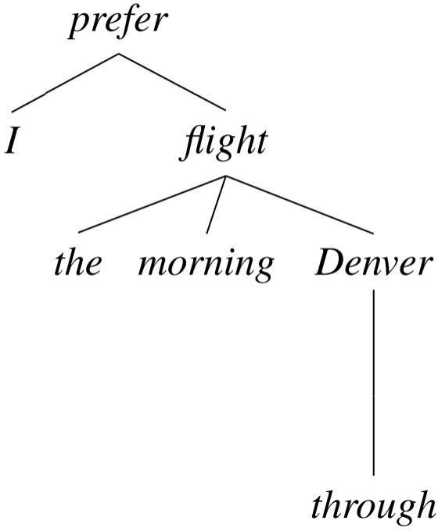
Dependency vs Constituency trees

Slide 7
Parsing Languages with Flexible Word Order
I prefer the morning flight through Denver
Я предпочитаю утренний перелет через Денвер

Slide 8
Languages with free word order
I prefer the morning flight through Denver
Я предпочитаю утренний перелет через Денвер Я предпочитаю через Денвер утренний перелет Утренний перелет я предпочитаю через Денвер Перелет утренний я предпочитаю через Денвер Через Денвер я предпочитаю утренний перелет Я через Денвер предпочитаю утренний перелет
...

Slide 9
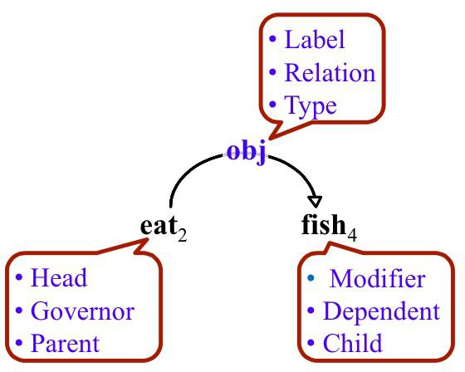
Dependency relations

Slide 10
Types of relationships
The clausal relations NSUBJ and DOBJ identify the arguments: the subject and direct object of the predicate cancel
The NMOD, DET, and CASE relations denote modifiers of the nouns flights and Houston.

Slide 11
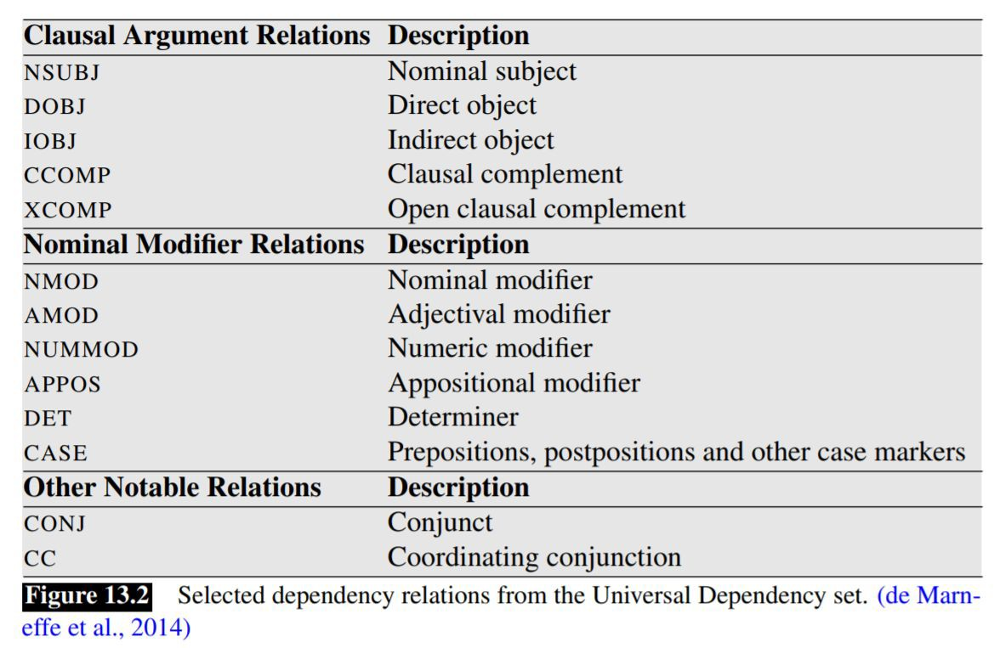
Grammatical functions

Slide 12
Dependency Constraints
Syntactic structure is complete (connectedness)
connectedness can be enforced by adding a special root node
Syntactic structure is hierarchical (acyclicity)
there is a unique pass from the root to each vertex
Every word has at most one syntactic head (single-head constraint)
except root that does not have incoming arcs
This makes the dependencies a tree

Slide 13
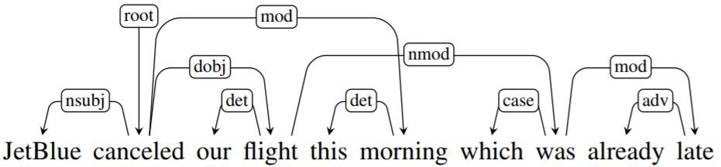
Projectivity
Projective parse
arcs don’t cross each other
mostly true for English
Non-projective structures are needed to account for
long-distance dependencies
flexible word order

Slide 14
Projectivity
Dependency grammars do not normally assume that all dependency-trees are projective, because some linguistic phenomena can only be achieved using non-projective trees.
But a lot of parsers assume that the output trees are projective
Reasons
conversion from constituency to dependency
the most widely used families of parsing algorithms impose projectivity

Slide 15
Detecting Projectivity/Non-Projectivity
The idea is to use the inorder traversal of the tree: <left-child, root, right-child>
This is well defined for binary trees. We need to extend it to n-ary trees.
If we have a projective tree, the inorder traversal will give us the original linear order.

Slide 16
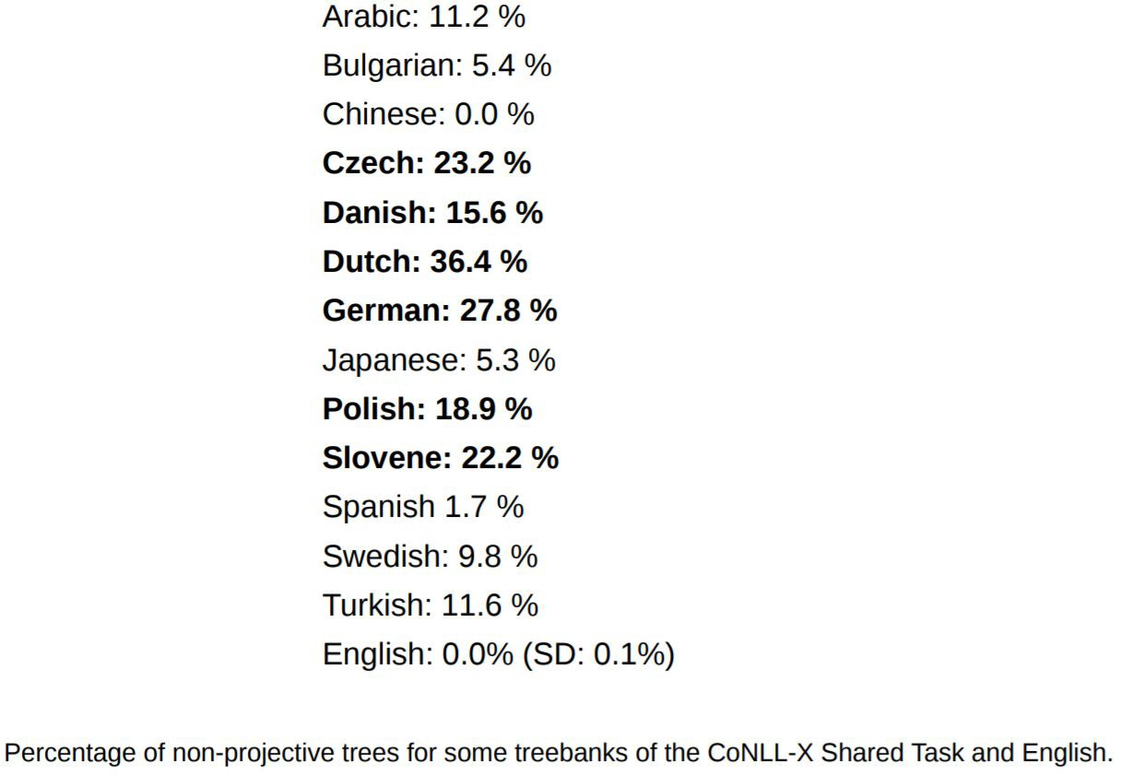
Non-Projective Statistics

Slide 17
Dependency Treebanks
the major English dependency treebanks converted from the WSJ sections of the PTB (Marcus et al., 1993)
OntoNotes project (Hovy et al. 2006, Weischedel et al. 2011) adds conversational telephone speech, weblogs, usenet newsgroups, broadcast, and talk shows in English, Chinese and Arabic
annotated dependency treebanks created for morphologically rich languages such as Czech, Hindi and Finnish, eg Prague Dependency Treebank (Bejcek et al., 2013)
http://universaldependencies.org/
122 treebanks, 71 languages

Slide 18

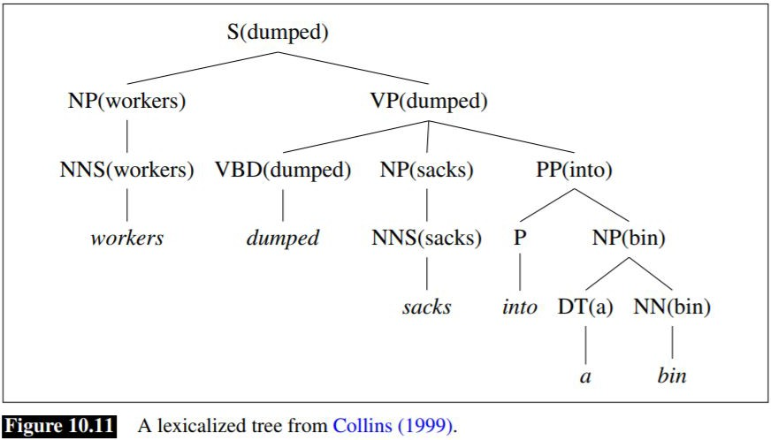
Conversion from constituency to dependency
Xia and Palmer (2001)
mark the head child of each node in a phrase structure, using the appropriate head rules
make the head of each non-head child depend on the head of the head-child

Slide 19
Parsing problem
The parsing problem for a dependency parser is to find the optimal dependency tree y given an input sentence x
This amounts to assigning a syntactic head i and a label l to every node j corresponding to a word x_{j} in such a way that the resulting graph is a tree rooted at the node 0

Slide 20
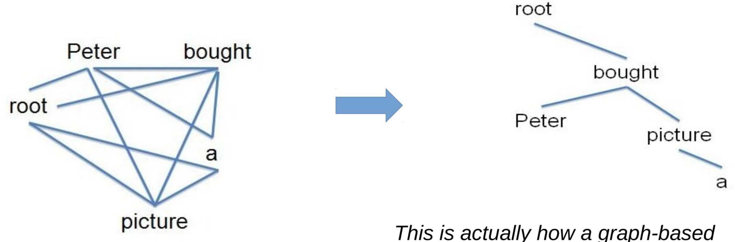
Parsing problem
This is equivalent to finding a spanning tree in the complete graph containing all possible arcs

Slide 21
Parsing algorithms
Transition based
greedy choice of local transitions guided by a goodclassifier
deterministic
MaltParser (Nivre et al. 2008)
Graph based
Minimum Spanning Tree for a sentence
McDonald et al.’s (2005) MSTParser
Martins et al.’s (2009) Turbo Parser

Slide 22
Transition Based Parsing
greedy discriminative dependency parser
motivated by a stack-based approach called shift-reduce parsing originally developed for analyzing programming languages (Aho & Ullman, 1972).
Nivre 2003

Slide 23
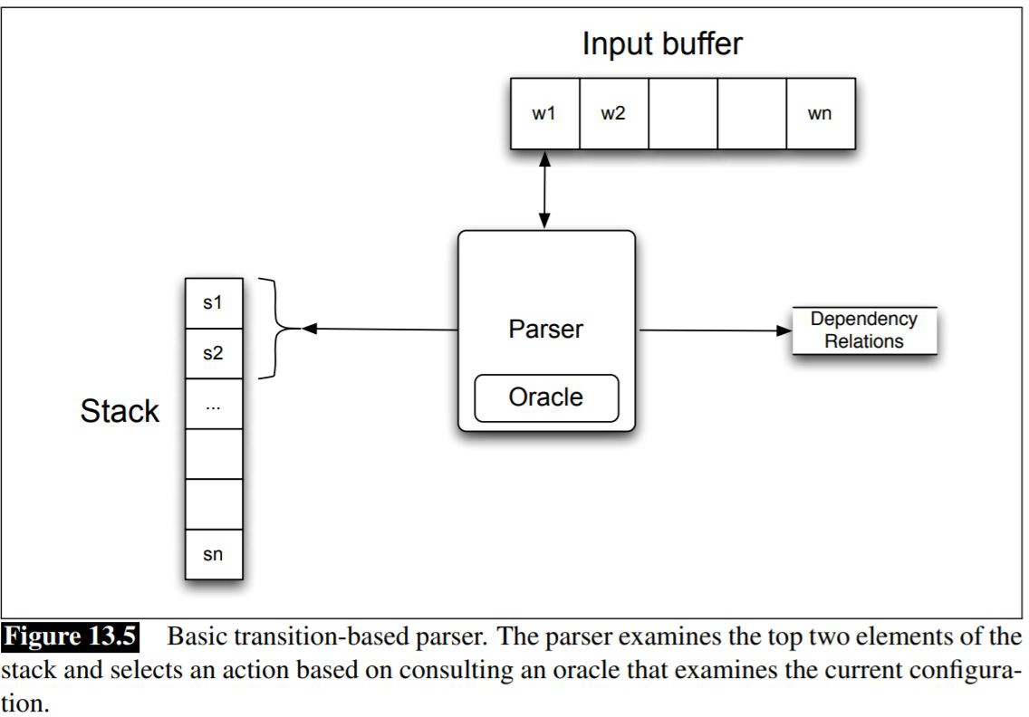
Configuration

Slide 24
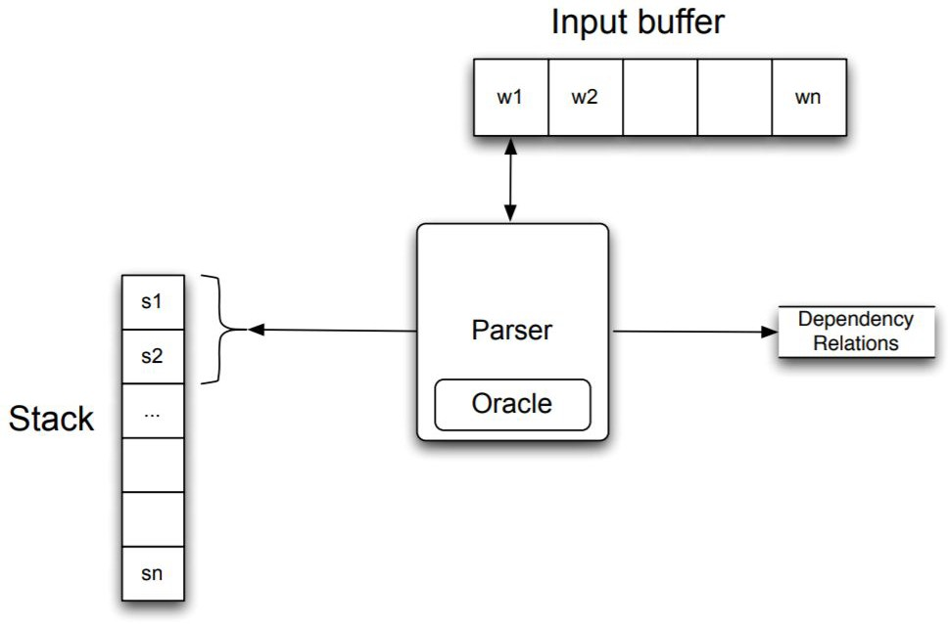
Operations
Buffer: unprocessed words
Stack: partially processed words
Oracle: a classifier
At each step choose:
Shift
LeftArc or Reduce left
RightArc or Reduce right

Slide 25
Shift-Reduce Parsing
Configuration:
Stack, Buffer, Oracle, Set of dependency relations Operations by a classifier at each step:
Shift
remove w1 from the buffer, add it to the top of the stack as s1
LeftArc or Reduce left
assert a head-dependent relation between s1 and s2
remove s2 from the stack
RightArc or Reduce right
assert a head-dependent relation between s2 and s1
remove s1 from the stack

Slide 26
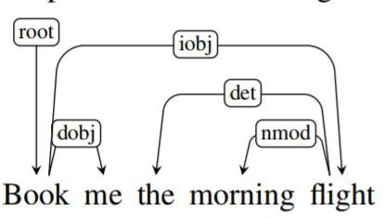
Shift-Reduce Parsing

Slide 27
Shift-Reduce Parsing

Slide 28
Shift-Reduce Parsing

Slide 29
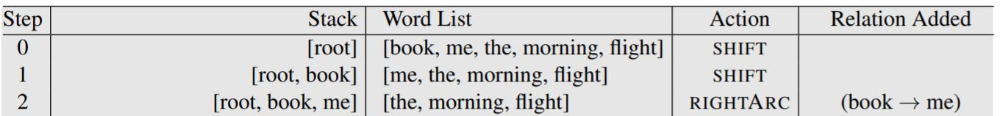

Shift-Reduce Parsing

Slide 30
Shift-Reduce Parsing

Slide 31
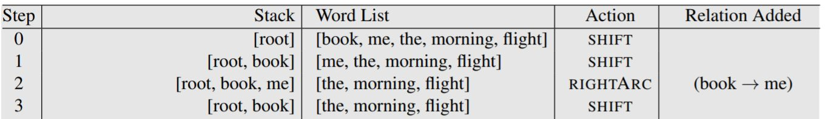
Shift-Reduce Parsing

Slide 32
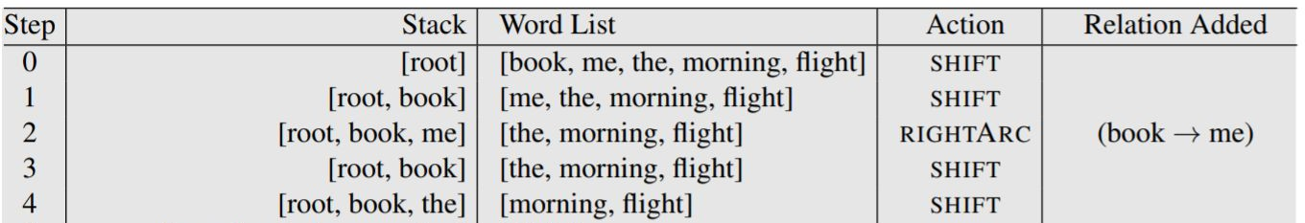
Shift-Reduce Parsing

Slide 33
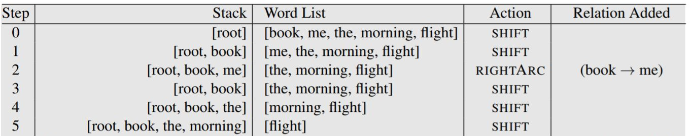
Shift-Reduce Parsing

Slide 34
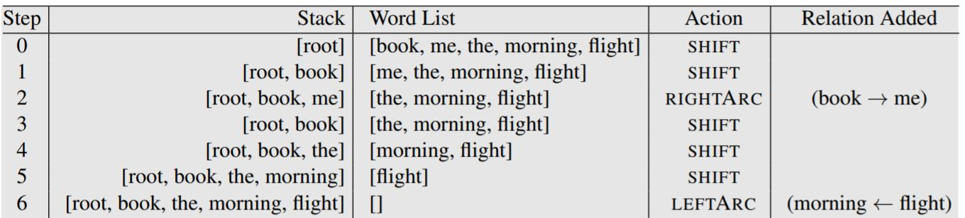
Shift-Reduce Parsing

Slide 35
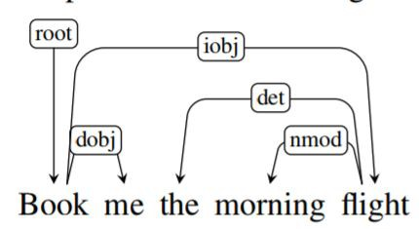
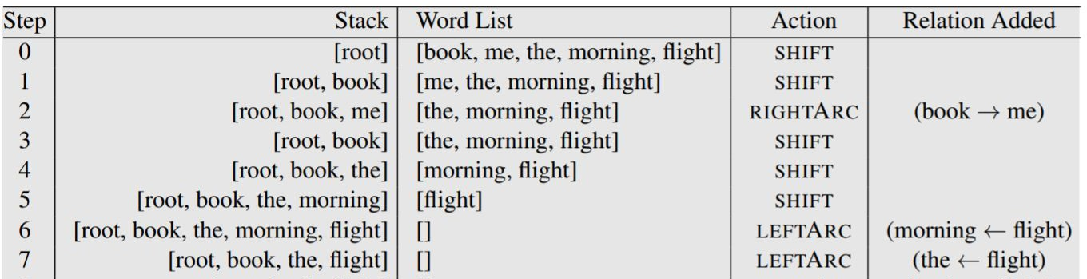
Shift-Reduce Parsing

Slide 36
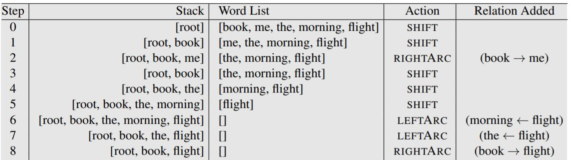
Shift-Reduce Parsing

Slide 37
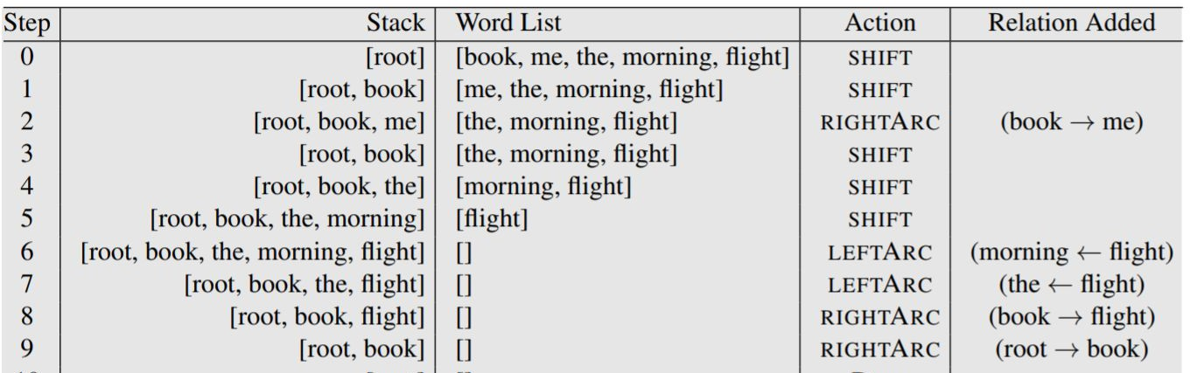
Shift-Reduce Parsing

Slide 38
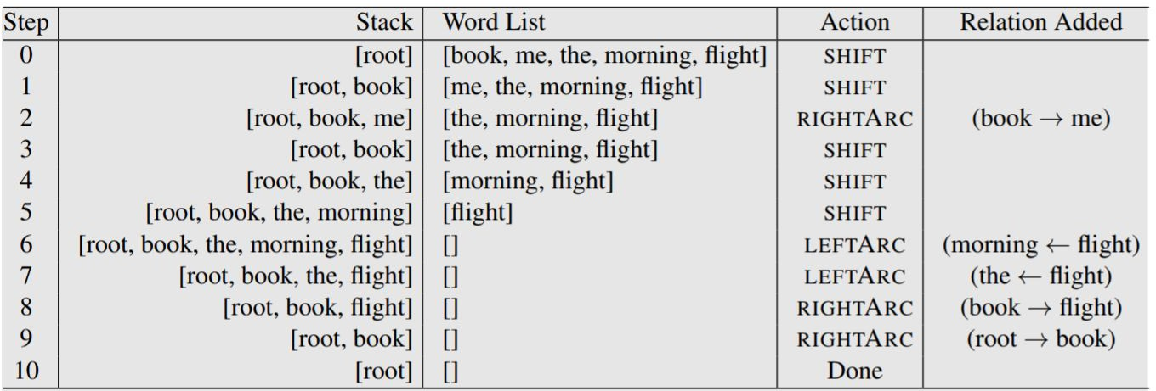
Shift-Reduce Parsing

Slide 39
Shift-Reduce Parsing
Configuration:
Stack, Buffer, Oracle, Set of dependency relations
Operations by a classifier at each step:
Complexity?
Shift
remove w1 from the buffer, add it to the top of the stack as s1
LeftArc or Reduce left
assert a head-dependent relation between s1 and s2
remove s2 from the stack
RightArc or Reduce right
Oracle decisions can correspond to unlabeled or labeled arcs
assert a head-dependent relation between s2 and s1
remove s1 from the stack

Slide 40
Training an Oracle
Oracle is a supervised classifier that learns a function from the configuration to the next operation
How to extract the training set?

Slide 41
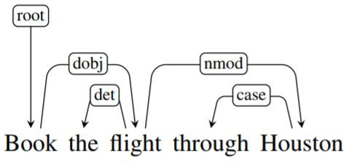
Training an Oracle
How to extract the training set?
if LeftArc → LeftArc
if RightArc
else → Shift
if s1 dependents have been processed → RightArc

Slide 42
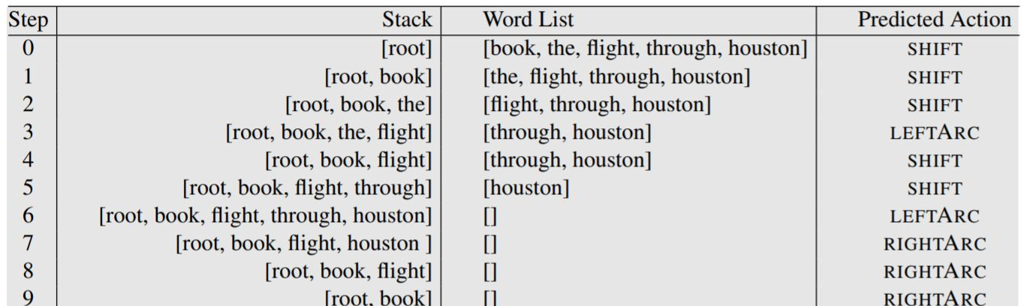
Training an Oracle
How to extract the training set?
if LeftArc → LeftArc
if RightArc
else → Shift
if s1 dependents have been processed → RightArc

Slide 43
Training an Oracle
Oracle is a supervised classifier that learns a function from the configuration to the next operation
How to extract the training set?
if LeftArc → LeftArc
if RightArc
if s1 dependents have been processed → RightArc
else → Shift
What features to use?

Slide 44
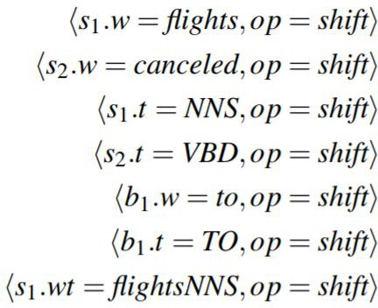
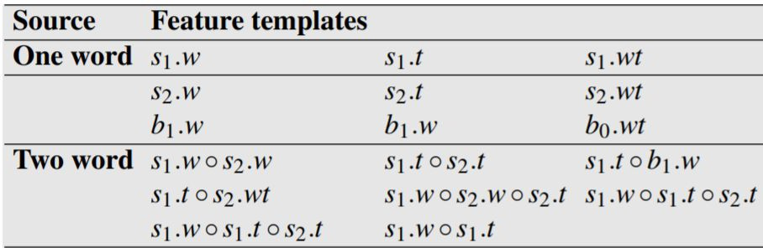
Features
POS, word-forms, lemmas on the stack/buffer
morphological features for some languages
previous relations
conjunction features (e.g. Zhang&Clark’08; Huang&Sagae’10; Zhang&Nivre’11)

Slide 45
Learning
Before 2014: SVMs,
After 2014: Neural Nets

Slide 46
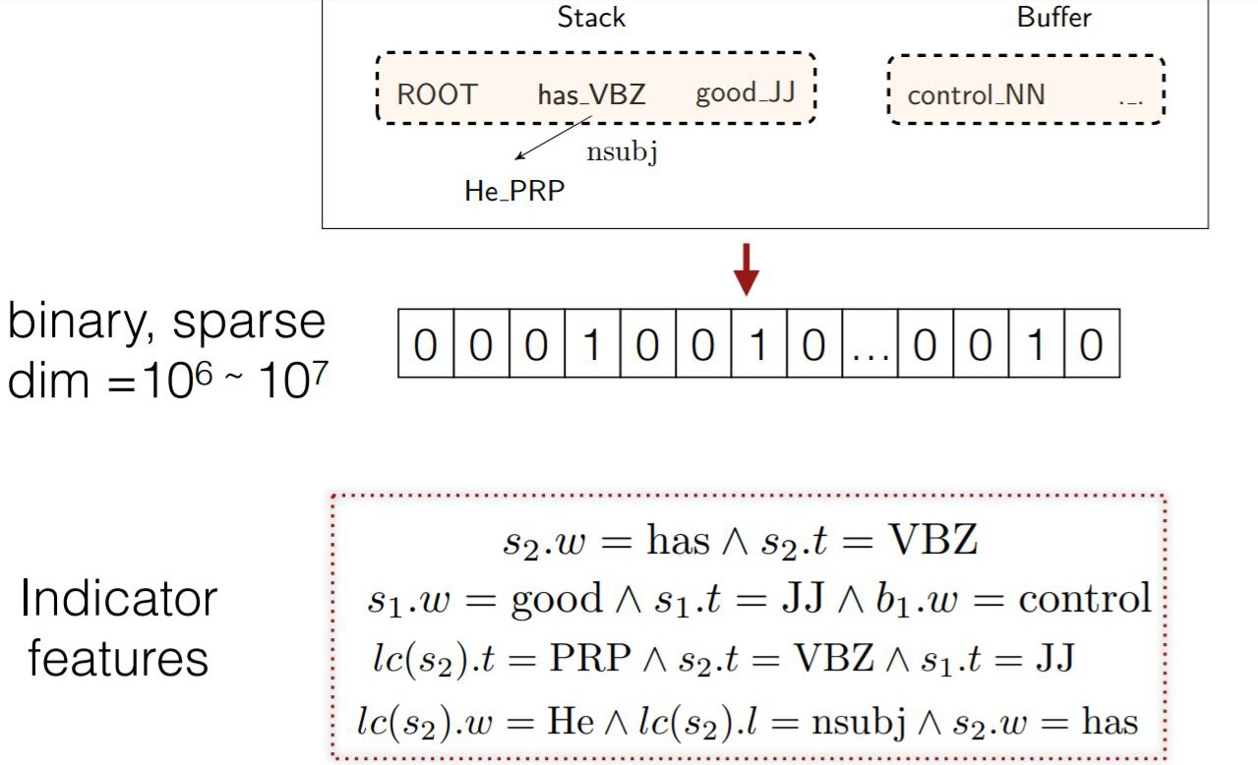
Chen & Manning 2014

Slide 47
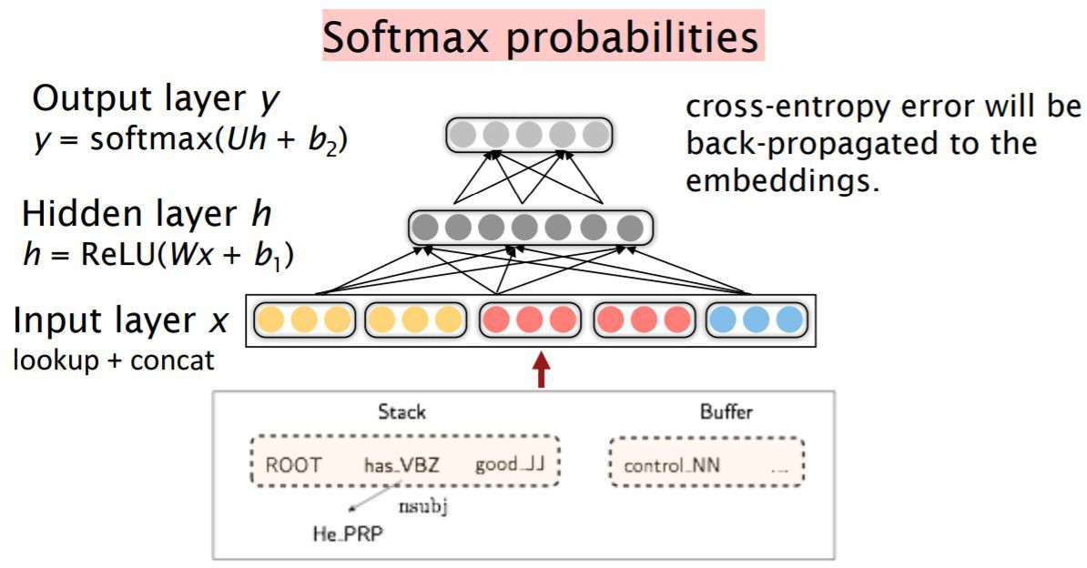
Chen & Manning 2014

Slide 48
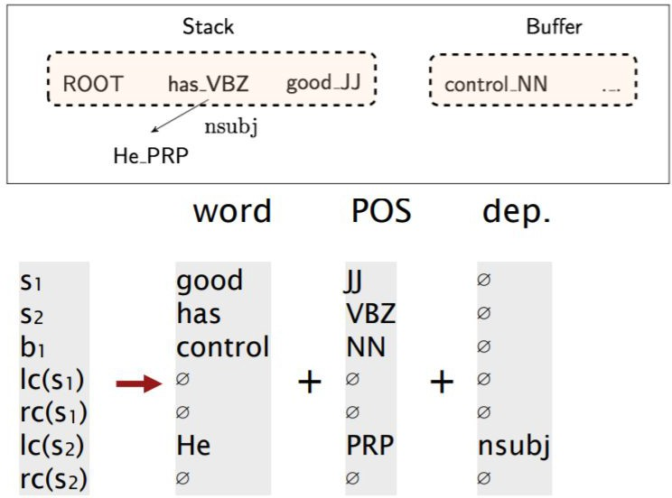
Chen & Manning 2014
Features
s1, s2, s3, b1, b2, b3
leftmost/rightmost children of s1 and s2
leftmost/rightmost grandchildren of s1 and s2
POS tags for the above
arc labels for children/grandchildren

Slide 49
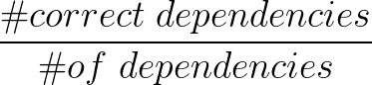
Evaluation of Dependency Parsers
LAS - labeled attachment score
A dependency is therefore scored as correct only if both nodes of the relation match existing gold-standard nodes.
Precision P is the number of correct relations divided by the number of system-produced nodes;
recall R is the number of correct relations divided by the number of gold-standard nodes.
We then define LAS as the F₁ score = 2PR / (P+R).
UAS - unlabeled attachment score
Percentage of words that get the correct head

Slide 50
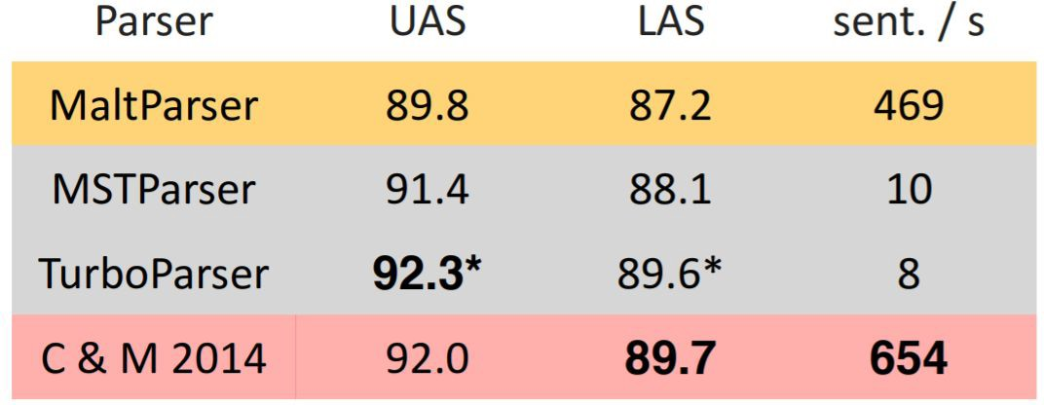
Chen & Manning 2014

Slide 51
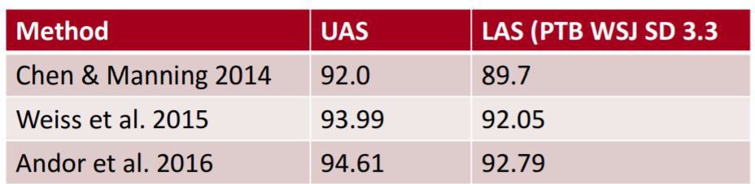
Follow-up

Slide 52
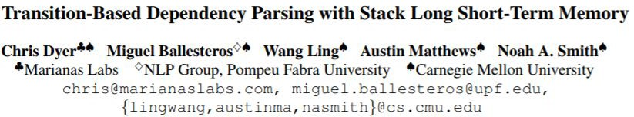
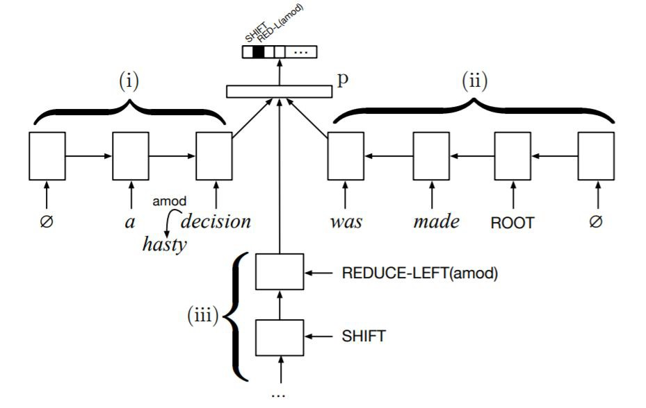
Stack LSTMs (Dyer et al. 2015)

Slide 53
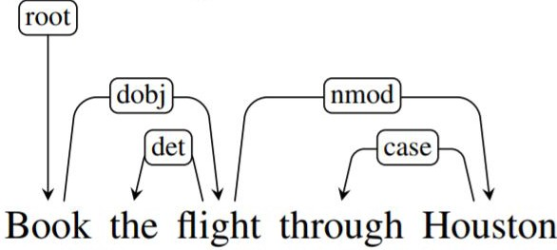
Arc-Eager
LEFTARC: Assert a head-dependent relation between s1 and b1; pop the stack.
RIGHTARC: Assert a head-dependent relation between s1 and b1; shift b1 to be s1.
SHIFT: Remove b1 and push it to be s1.
REDUCE: Pop the stack.

Slide 54
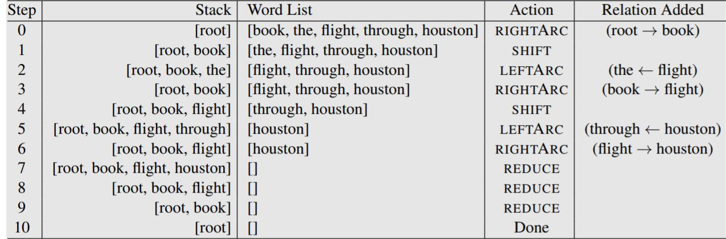
Arc-Eager

Slide 55
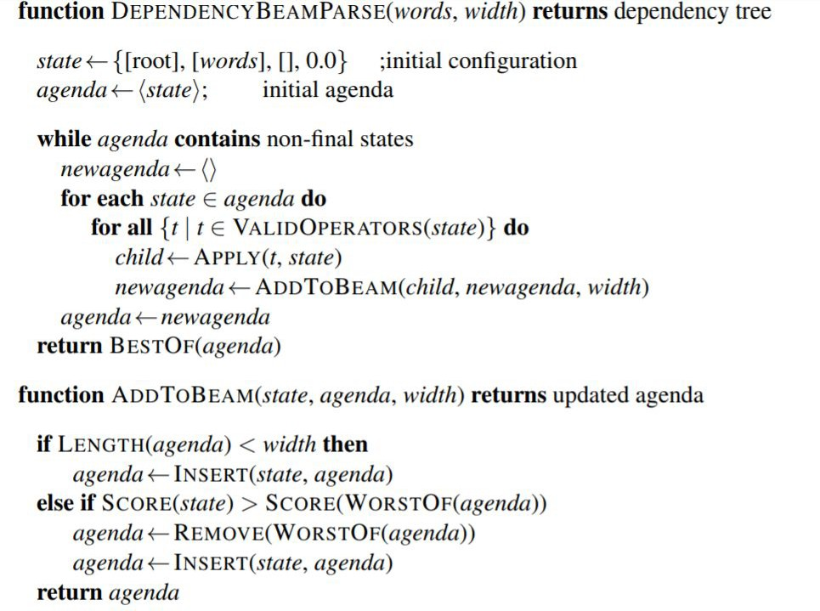
Beam Search

Slide 56
Parsing algorithms
Transition based
greedy choice of local transitions guided by a goodclassifier
deterministic
MaltParser (Nivre et al. 2008), Stack LSTM (Dyer et al. 2015)
Graph based
Minimum Spanning Tree for a sentence
non-projective
globally optimized
McDonald et al.’s (2005) MSTParser
Martins et al.’s (2009) Turbo Parser

Slide 57












Dependency parsing
Transition-based (shift-reduce) parsing:
Greedy choice of local transitions guided by a good classifier.
Examples: MaltParser [Nivre et al. 2008], Stack LSTM [Dyer et al. 2015]
Graph-based dependency parsing:
Given scores for every pair of words, find the (globally) highest scoring set of edges.
Examples: MSTParser [McDonald et al. 2005], TurboParser [Martins et al. 2009],
Input buffer
w1
w2
wn
s1
Parser
Dependency
s2
Relations
Stack
...
Oracle
sn
4
4
12
5
8
root
Book
that
flight
6
7
Deep Biaffine [Dozat et al. 2017]
7
5
3

Slide 58
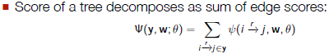
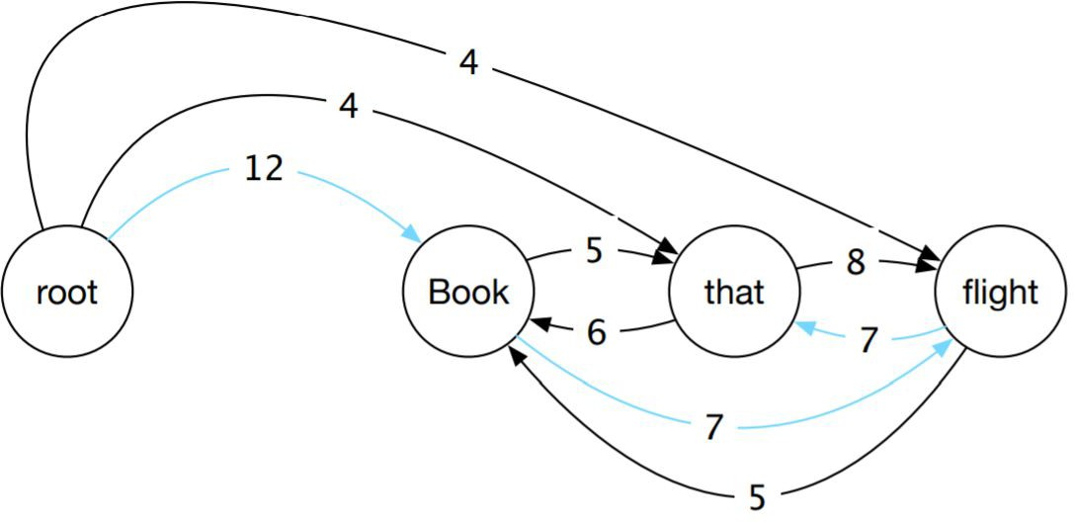
Graph-Based Parsing Algorithms
edge-factored approaches
Start with a fully-connected directed graph
Find a Minimum Spanning Tree
Chu and Liu (1965) and Edmonds (1967) algorithm

Slide 59
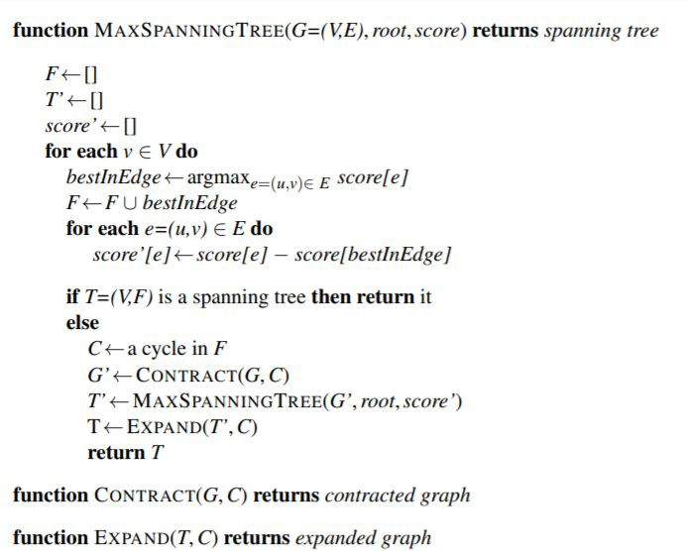
Chu-Liu Edmonds algorithm
Select best incoming edge for each node
Subtract its score from all incoming edges Stopping condition
Contract nodes if there are cycles Recursively compute MST
Expand contracted nodes

Slide 60
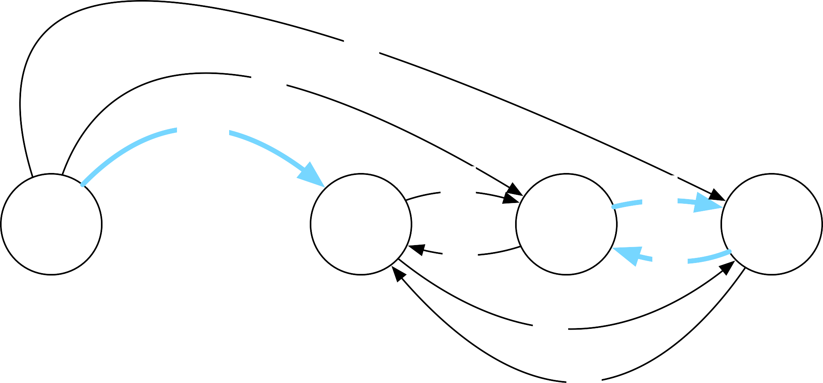
Chu-Liu-Edmonds algorithm
Select best incoming edge for each node
4
4
12
Book 12
5
that 7
8
flight 8
root
6
7
7
5

Slide 61
Chu-Liu-Edmonds algorithm
Subtract its score from all incoming edges
4
-8
4
-7
12
-12
root
Book 12
⁵-7
that 7
⁸-8
flight 8
6
7
-7
-12
₇ -8
⁵ -12

Slide 62
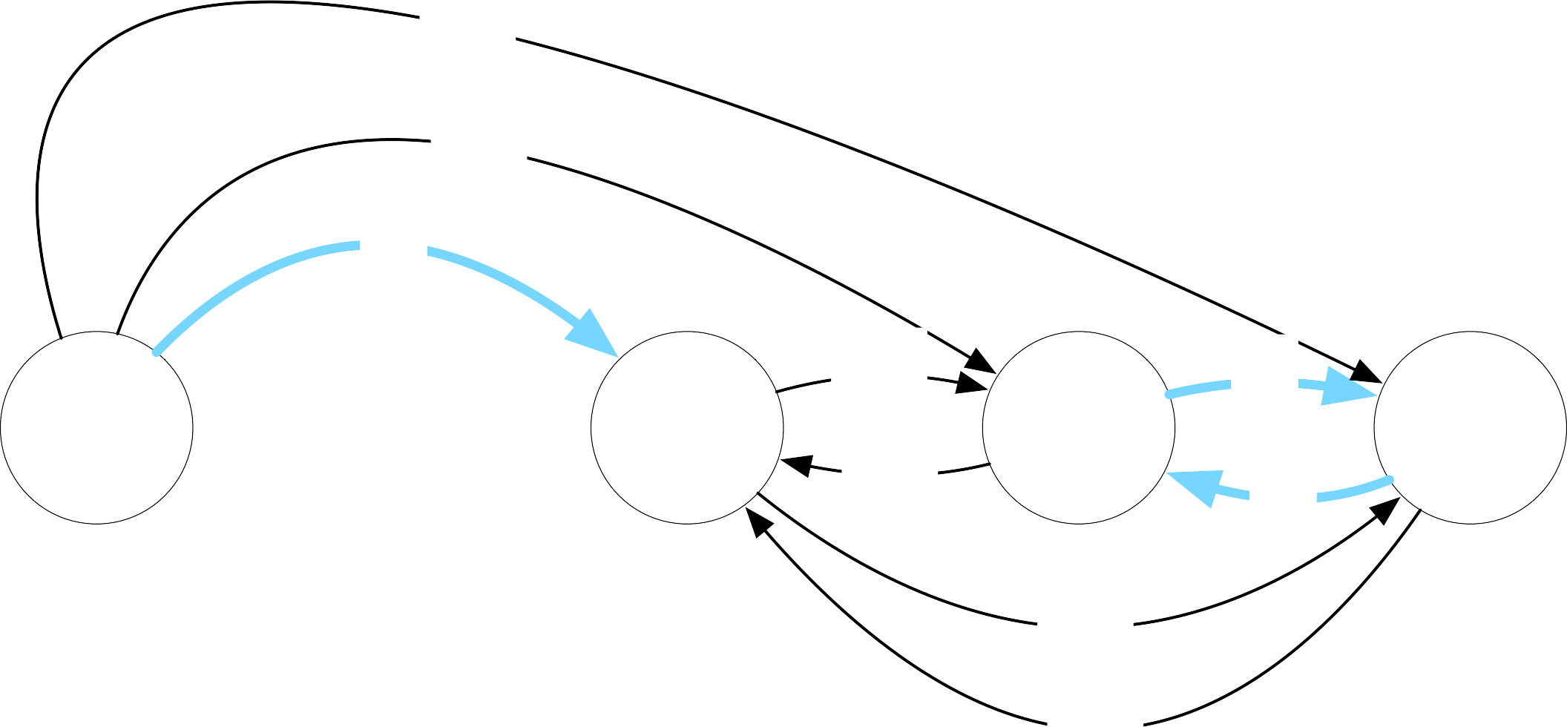
Chu-Liu-Edmonds algorithm
Subtract its score from all incoming edges
-4
-3
0
Book 12
-2
-6
that 7
0
flight 8
root
0
-1
-7

Slide 63


Chu-Liu-Edmonds algorithm
Contract nodes if there are cycles
-4
-3
0
Book 12
-2
-6
that 7
0
flight 8
root
0
-1
-7

Slide 64





Chu-Liu-Edmonds algorithm
Contract nodes if there are cycles
-4
-3
0
-2
root
Book
-6
tf
-1
-7

Slide 65

Chu-Liu-Edmonds algorithm
Recursively compute MST
-4
-3
0
Book 0
-2
tf
-1
root
-6
-1
-7

Slide 66
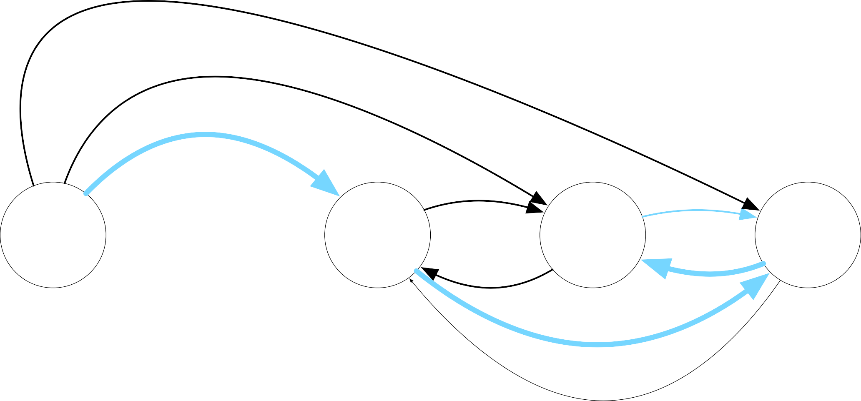
Chu-Liu-Edmonds algorithm
Expand contracted nodes
Deleted from cycle
root
Book
that
flight

Slide 67
Chu-Liu-Edmonds algorithm
runtime?
naive: O(n³)
fancy: O(n² + nlogn)
what about labeled parsing?
13

Slide 68
Graph-based dependency parsing
Edge-factored (or arc-factored) approaches: score of a tree decomposes as sum of edge scores.
Can also define higher-order models: score decomposes as a sum of scores
of local subgraphs.
First order h m
Second order h s m g h m
Third order g h s m h t s m
Have efficient (polynomial time) algorithms for second [Eisner 1996] and third order [Koo and Collins, 2010] projective dependency parsing.
Second order parsing is NP-hard for non-projective dependency graphs [McDonald and Pereira, 2006]!
15

Slide 69
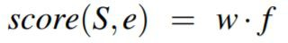
Scores
Wordforms, lemmas, and parts of speech of the headword and its dependent.
Corresponding features derived from the contexts before, after and between the words.
Word embeddings.
The dependency relation itself.
The direction of the relation (to the right or left).
The distance from the head to the dependent.

Slide 70
Classic graph-based parsing features
Word forms, lemmas, parts of speech of the head word and its dependent
Corresponding features derived from the contexts before, after, between words
Word embeddings
Dependency relation
Direction of the relation (right or left)
Distance from the head to the dependent
Combinations of all of the above
17

Slide 71

Graph-based neural network parsers
per-token features
neural network
word embeddings
Janet
will
back
the
bill
18

Slide 72
Graph-based neural network parsers
per-token features
neural network
word embeddings pos embeddings
Janet/NNP
will/MD
back/VB
the/DT
bill/NN
19

Slide 73
Graph-based neural network parsers
root → Janet
will → Janet
back → Janet
the → Janet
bill → Janet
Janet → bill
…
edge features
per-token features
neural network
word embeddings pos embeddings
Janet/NNP
will/MD
back/VB
the/DT
bill/NN
19

Slide 74
Graph-based neural network parsers
root → Janet
will → Janet
back → Janet
the → Janet
bill → Janet
Janet → bill
…
edge features
per-token features
neural network
word embeddings pos embeddings
Janet/NNP
will/MD
back/VB
the/DT
bill/NN
19

Slide 75
Graph-based neural network parsers
Concat + feed-forward [Kiperwasser and Goldberg, 2016]
+
MLP
MLP
MLP
MLP
Vthe
Vbrown
Vfox
Vjumped
V⇤
concat
concat
concat
concat
concat
LST M ^{b}
LST M ^{b}
LST M ^{b}
LST M ^{b}
LST M ^{b}
LST M ^{f}
LST M ^{f}
LST M ^{f}
LST M ^{f}
LST M ^{f}
xthe
xbrown
xfox
xjumped
x⇤
20

Slide 76
Graph-based neural network parsers
Concat + feed-forward [Kiperwasser and Goldberg, 2016]
+
MLP
MLP
MLP
MLP
Vthe
Vbrown
Vfox
Vjumped
V⇤
concat
concat
concat
concat
concat
LST M ^{b}
LST M ^{b}
LST M ^{b}
LST M ^{b}
LST M ^{b}
stacked LSTM token encoder
LST M ^{f}
LST M ^{f}
LST M ^{f}
LST M ^{f}
LST M ^{f}
xthe
xbrown
xfox
xjumped
x⇤
20

Slide 77
Graph-based neural network parsers
Concat + feed-forward [Kiperwasser and Goldberg, 2016]
+
concat head, dependent as input to MLP
MLP
MLP
MLP
MLP
Vthe
Vbrown
Vfox
Vjumped
V⇤
concat
concat
concat
concat
concat
LST M ^{b}
LST M ^{b}
LST M ^{b}
LST M ^{b}
LST M ^{b}
stacked LSTM token encoder
LST M ^{f}
LST M ^{f}
LST M ^{f}
LST M ^{f}
LST M ^{f}
xthe
xbrown
xfox
xjumped
x⇤
20

Slide 78
Graph-based neural network parsers
Concat + feed-forward [Kiperwasser and Goldberg, 2016]
Hinge loss:
+
concat head, dependent as input to MLP
MLP
MLP
MLP
MLP
Vthe
Vbrown
Vfox
Vjumped
V⇤
concat
concat
concat
concat
concat
LST M ^{b}
LST M ^{b}
LST M ^{b}
LST M ^{b}
LST M ^{b}
stacked LSTM token encoder
LST M ^{f}
LST M ^{f}
LST M ^{f}
LST M ^{f}
LST M ^{f}
xthe
xbrown
xfox
xjumped
x⇤
20

Slide 79
Graph-based neural network parsers
Concat + feed-forward [Kiperwasser and Goldberg, 2016]
Hinge loss:
w/ loss augmented inference:
+
concat head, dependent as input to MLP
MLP
MLP
MLP
MLP
Vthe
Vbrown
Vfox
Vjumped
V⇤
concat
concat
concat
concat
concat
LST M ^{b}
LST M ^{b}
LST M ^{b}
LST M ^{b}
LST M ^{b}
stacked LSTM token encoder
LST M ^{f}
LST M ^{f}
LST M ^{f}
LST M ^{f}
LST M ^{f}
xthe
xbrown
xfox
xjumped
x⇤
20

Slide 80


Graph-based neural network parsers
Biaffine classifier [Dozat and Manning, 2017]
_{H}(arc-dep) _{⊕ 1}
_{U}(arc)
_{H}(arc-head)
_{S}(arc)
T
1
1
1
1
·
·
=
_{MLP: h}(arc-dep)_{, h}(arc-head)
i i
BiLSTM: r_{i}
Embeddings: x_{i}
...
root
ROOT
Kim NNP
21

Slide 81
Graph-based neural network parsers
Biaffine classifier [Dozat and Manning, 2017]
_{H}(arc-dep) _{⊕ 1}
_{U}(arc)
_{H}(arc-head)
_{S}(arc)
T
1
1
1
1
·
·
=
_{MLP: h}(arc-dep)_{, h}(arc-head)
i i
BiLSTM: r_{i}
Embeddings: x_{i}
...
stacked LSTM token encoder
root
ROOT
Kim NNP
21

Slide 82
Graph-based neural network parsers
Biaffine classifier [Dozat and Manning, 2017]
_{H}(arc-dep) _{⊕ 1}
_{U}(arc)
_{H}(arc-head)
_{S}(arc)
T
1
1
1
1
·
·
=
_{MLP: h}(arc-dep)_{, h}(arc-head)
i i
BiLSTM: r_{i}
Embeddings: x_{i}
MLPhead
MLPdep
...
stacked LSTM token encoder
root
ROOT
Kim NNP
21

Slide 83
Graph-based neural network parsers
Biaffine classifier [Dozat and Manning, 2017]
21

Slide 84
Graph-based dependency parsing
Edge-factored (or arc-factored) approaches: score of a tree decomposes as sum of edge scores.
r
How to parameterize ?
How to learn θ ?
Locally normalized: predict each head and its label, softmax, log loss.
Hinge loss: Find the best scoring tree, and penalize edges not in the gold tree (with a margin).
Globally normalized CRF: can compute marginals/partition function using a variant of Kirchhoff’s Matrix-Tree Theorem [Tutte, 1984; Koo et al. 2007].
22

Slide 85
Graph-based vs. transition-based parsing?
Transition-based
Fast
Greedy / local inference
Maybe closer to humans?
Input buffer
Graph-based
Slow
Exact inference
More accurate
w1
w2
wn
4
12
4
s1
Dependency
5
8
s2
Parser
Relations
root
Book
that
flight
Oracle
6
7
Stack
...
7
5
sn
23

Slide 86
Graph-based vs. transition-based parsing?
Dependency parsing: accuracy vs. speed
Speed (sentences/sec)
Accuracy (UAS)
24

Slide 87

Graph-based vs. transition-based parsing?
Dependency parsing: accuracy vs. speed
Speed (sentences/sec)
Graph-based
TurboParser [Martins et al. 2010] [Zhang & McDonald 2014]
Accuracy (UAS)
24

Slide 88

Graph-based vs. transition-based parsing?
Dependency parsing: accuracy vs. speed
Speed (sentences/sec)
Transition-based
MaltParser [Nivre et al. 2009] TurboParser [Martins et al. 2010] [Zhang & McDonald 2014]
Graph-based
Accuracy (UAS)
24

Slide 89

Graph-based vs. transition-based parsing?
Dependency parsing: accuracy vs. speed
Speed (sentences/sec)
Structured prediction cascades
[Rush & Petrov 2012; Weiss & Taskar 2010]
MaltParser [Nivre et al. 2009]
TurboParser [Martins et al. 2010] [Zhang & McDonald 2014]
Transition-based
Graph-based
Accuracy (UAS)
24

Slide 90

Graph-based vs. transition-based parsing?
Dependency parsing: accuracy vs. speed
Speed (sentences/sec)
Structured prediction cascades
FF neural nets
[Chen & Manning 2014] [Rush & Petrov 2012; Weiss & Taskar 2010]
MaltParser [Nivre et al. 2009]
TurboParser [Martins et al. 2010] [Zhang & McDonald 2014]
Transition-based
Graph-based
Accuracy (UAS)
24

Slide 91


Graph-based vs. transition-based parsing?
Dependency parsing: accuracy vs. speed
[Strubell et al. 2015]
transition-based w/
dynamic feature selection
[Strubell et al. 2015]
Speed (sentences/sec)
Structured prediction cascades
FF neural nets
[Chen & Manning 2014] [Rush & Petrov 2012; Weiss & Taskar 2010]
MaltParser [Nivre et al. 2009]
TurboParser [Martins et al. 2010] [Zhang & McDonald 2014]
Transition-based
Graph-based
Accuracy (UAS)
24

Slide 92

Graph-based vs. transition-based parsing?
Dependency parsing: accuracy vs. speed
Speed (sentences/sec)
transition-based w/
dynamic feature selection
Structured prediction cascades
FF neural nets
Stacked LSTMs
[Dozat and Manning 2017]*
Transition-based
Graph-based
94
95
96
Accuracy (UAS)
25

Slide 93
Graph-based vs. transition-based parsing?
Dependency parsing: accuracy vs. speed
Speed (sentences/sec)
transition-based w/
dynamic feature selection
Structured prediction cascades
FF neural nets
Stacked LSTMs
[Dozat and Manning 2017]*
Transition-based
*on GPU!!
Graph-based
94
95
96
Accuracy (UAS)
25

Slide 94
Summary
Transition-based
▪ + Fast
▪ + Rich features of context
- Greedy decoding
Graph-based
▪ + Exact or close to exact decoding
- Weaker features
Well-engineered versions of the approaches achieve comparable accuracy (on English), but make different errors
→ combining the strategies results in a substantial boost in performance

